Slide 1
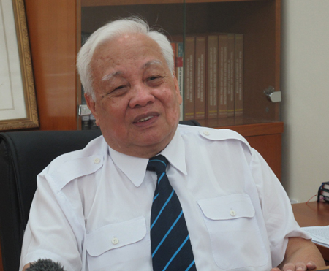
Nguyễn Văn Hiệu
Notes:
# Name Nguyễn Văn Hiệu # Textbook Knight, Physics for Scientists and Engineers: A Strategic Approach with Modern Physics, 3rd Edition, Chapter 38 # Description Nguyễn Văn Hiệu (born 1938) is a Vietnamese professor, physicist, and politician. He studied physics in Vietnam and then later, the Soviet Union. He was the head of the research team at the Soviet Dubna Institute for Nuclear Research. He’s the founder of VNU University of Engineering and Technology in Vietnam. He is one of the best professor, PhD in the field of theoretical physics and mathematical physics of Vietnam. # Sources http://vnfoundation.org/dr-nguyen-van-hieu # Photo http://vnfoundation.org/wp-content/uploads/2017/02/nguyen-van-hieu.jpg

